Slide 1
CSE 230
Computer Organization
Dr Gamal Fahmy
Some slides are taken from the Tylavsky CD

Slide 2
Cycles for an instruction
Previously we said that every instruction will have a fetch and execute instruction
This is not always the case !!!
Some architectures contain several cycles for EVERY instruction (fetch, fetch another operand, update an operand in memory)
while the number of cycles (micro instructions) is an organizational issue, whether all cycles are read in one instruction or more it is an architectural issue.
Pipelining could be made for cycles (organizational) discussed later !!!

Slide 3
Control unit Design
To complete our microprocessor we will need to add two major circuits:
  Address Generation Circuit
  Controller
Let’s look at the address generation circuit first.
To understand why the circuit is designed the way it is, we need to know how we will store instructions in memory.

Slide 4
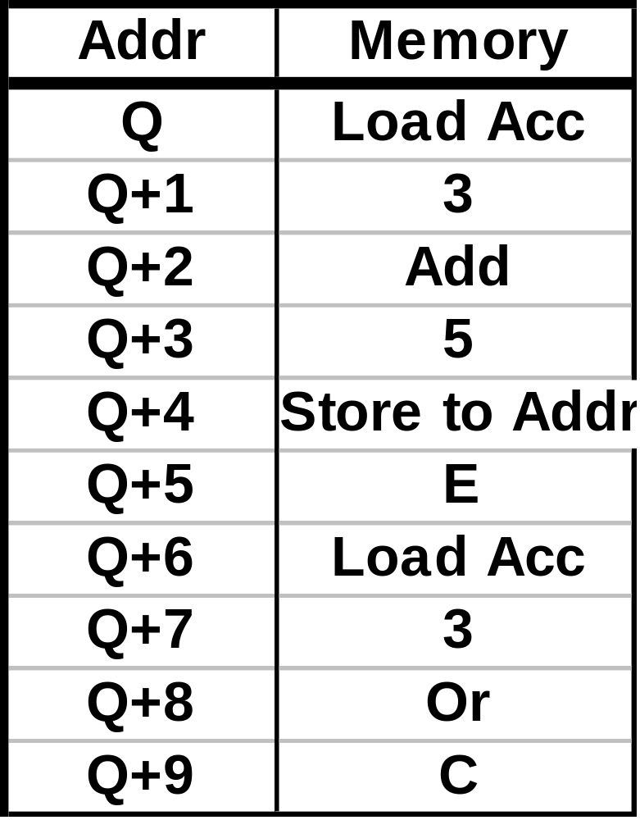
A program portion in memory might look like:
}
Load the accumulator with ‘3’.
}
Add ‘5’ to the accumulator.
}
Store results from ACC to memory location ‘E’.
}
Etc.
Our ROM-based controller will have the capability of implementing each of these instructions.

Slide 5
Our instruction layout shows that instruction (with data) to be executed consecutively, are laid out in consecutive memory locations.
We will need circuitry that can both:
  access memory locations sequentially, and,
  access a memory location out of order (e.g. “Store to location E”).

Slide 6
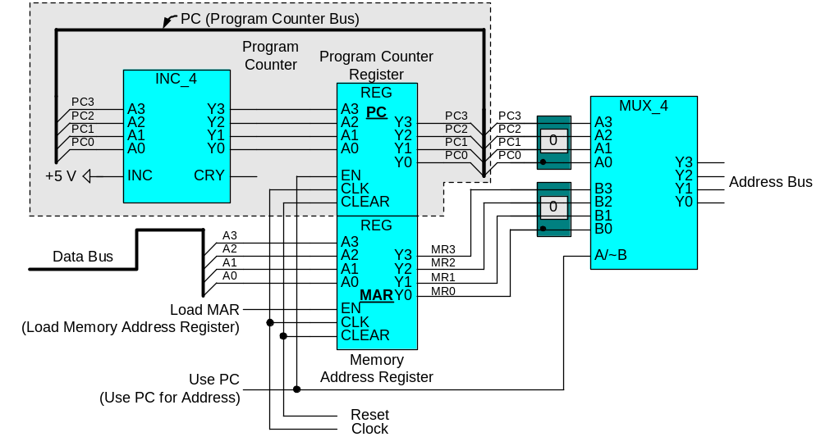
1
0
This program counter and address generation circuit can do this.
Let’s first look at how the PC operates to access locations sequentially.
0
1
2
1
2
3
0
1
2
0
1
2

Slide 7
Let’s look at how the PC can drive the address bus with a non-sequential address.
2
3
2
2
E
E
E
Now let’s place the PC in the partially completed design.

Slide 8
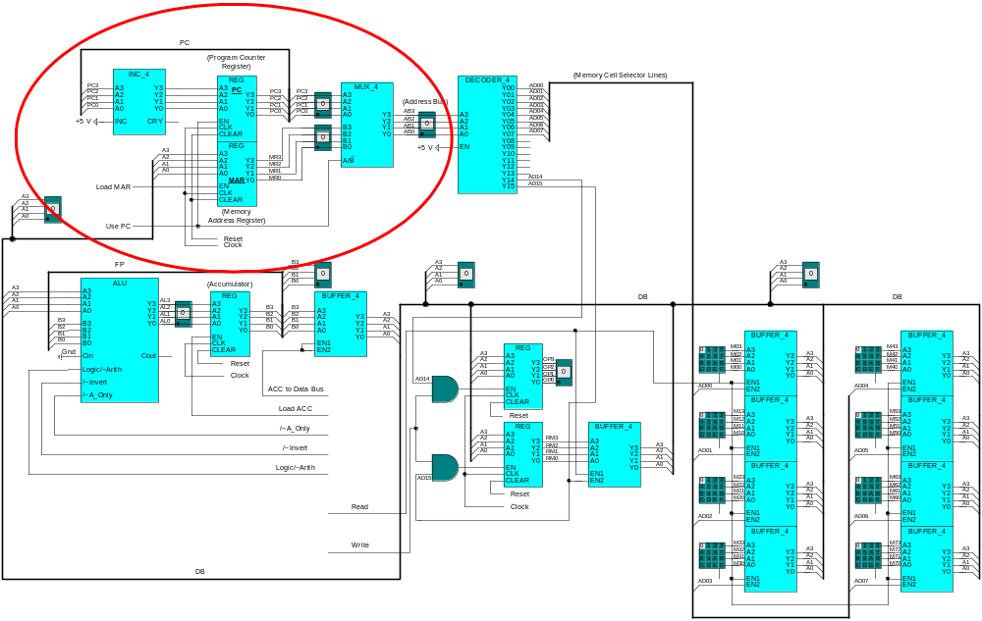
Every switch we control manually (except clock and
reset) will have to be controlled by our controller.

Slide 9
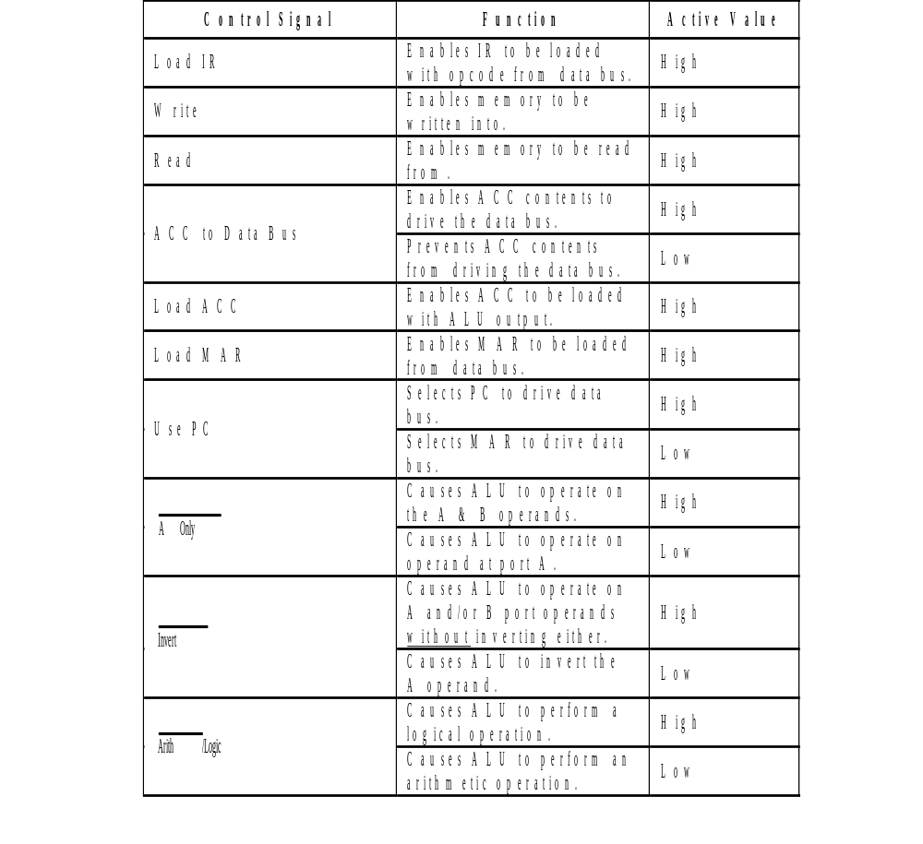
Controller Output Signals
From our experience of manually controlling our processor, we can create the list of output signals the controller will need to provide and the function they perform.
1
Next, let’s design a synchronized Mealy machine controller to control these signals.
1. When we build our controller we’ll see that ‘Load IR’ will control whether we treat the byte being fetched from memory as an instruction or data.

Slide 10
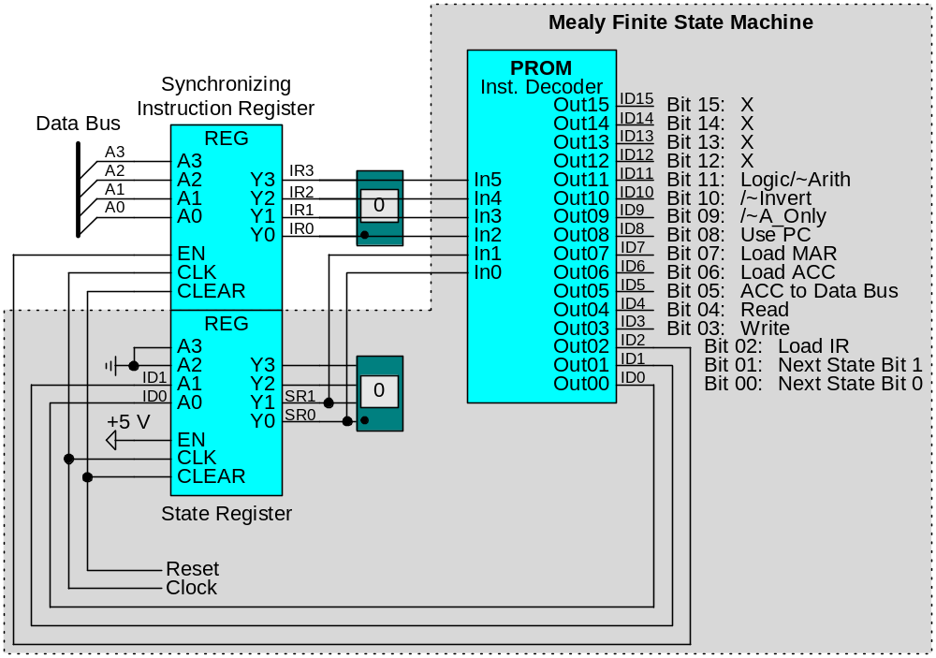
Our synchronized Mealy machine controller has the following block-diagram form:
Synchronized
Input
Control
Outputs
Functions
External
Input
{
2 State
Variables
Fedback

Slide 11
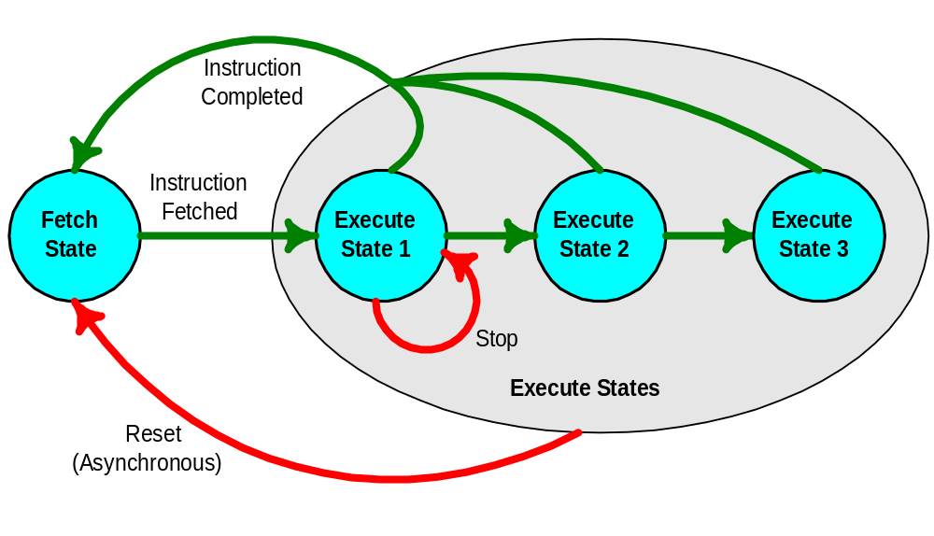
Because our controller has only 2 state variables, it can cycle through at most 4 states.
(00)
(01)
(10)
(11)

Slide 12
  Fetch State – Used to fetch an opcode from memory
  Execute States – Performs operations needed to execute an instruction
  The controller effects these operations by controlling devices to:
    Route data.
    Perform logical/arithmetic operations (ALU, increment in address generation).
    Enable registers to lock-in data on neg. clock edge.

Slide 13
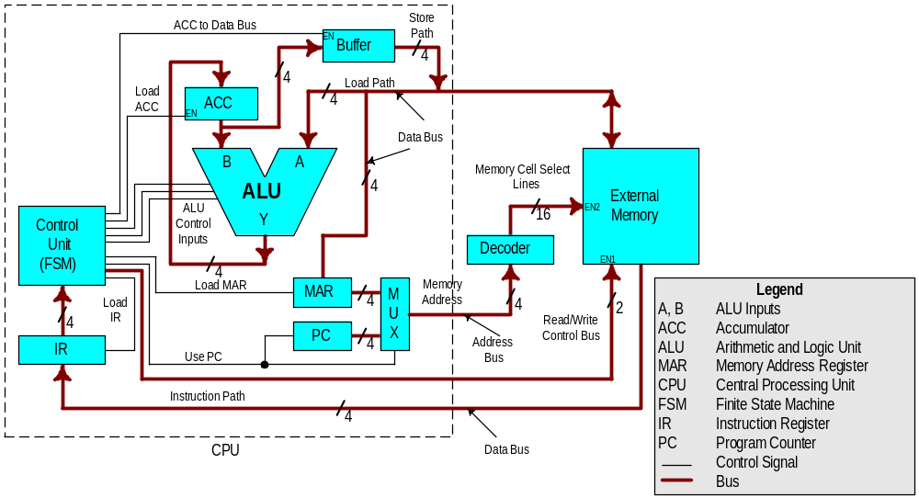
To understand how our controller will control each major subcircuit to execute an instruction, we need to understand the microprocessor architecture.
The Decoder is like a MAR, and there is no MDR in this micro processor

Slide 14
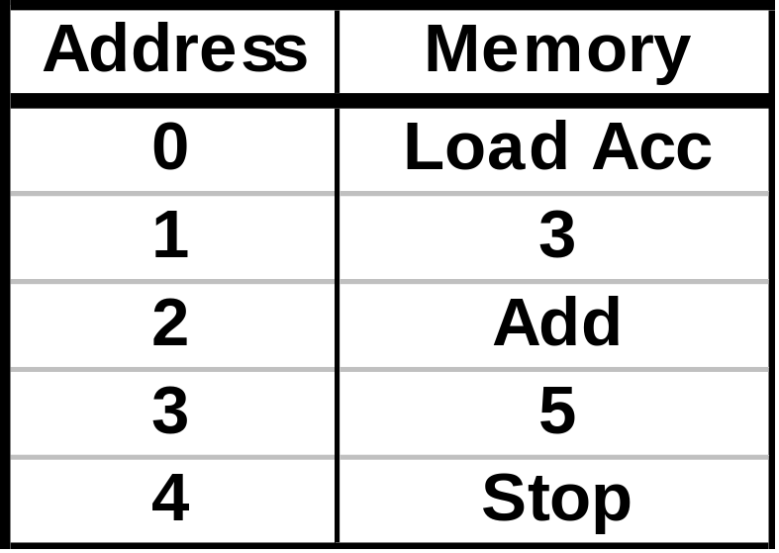
Let’s look at the sequence of control signals our controller will need to issue to perform the following program:
Reset the microprocessor
Fetch the ‘Load ACC’ Opcode.
Execute the ‘Load ACC Operation.
Fetch the Add Opcode.
Execute the ‘Add’ Operation.
Stop
Executing each instruction may require that we cycle through several states.

Slide 15
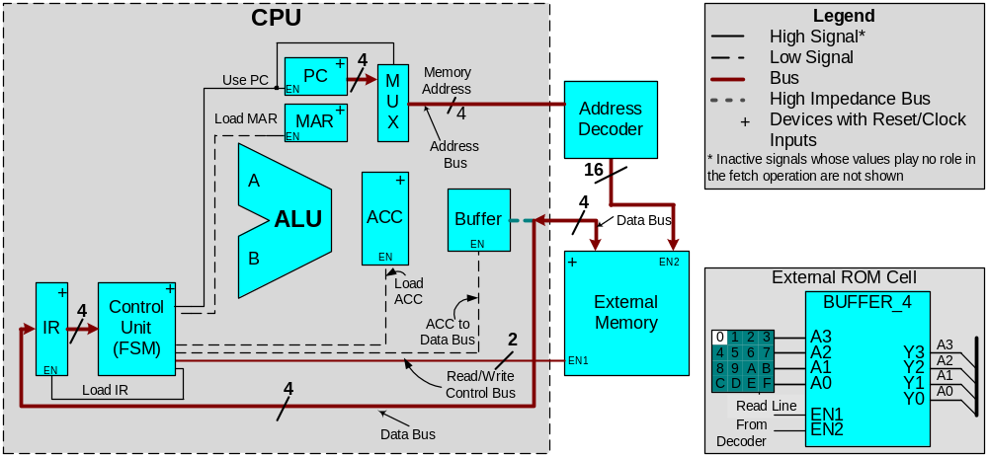
Enable
Control
Data
  Fetch the ‘Load ACC’ opcode into the IR.
Enable registers/Control the PC to increment.
Route Data
Enable memory causes memory data to be routed on data bus.
PC incremented and IR loaded on clock pulse.
1
LDA
3
Add
5
Stop
LDA

Slide 16
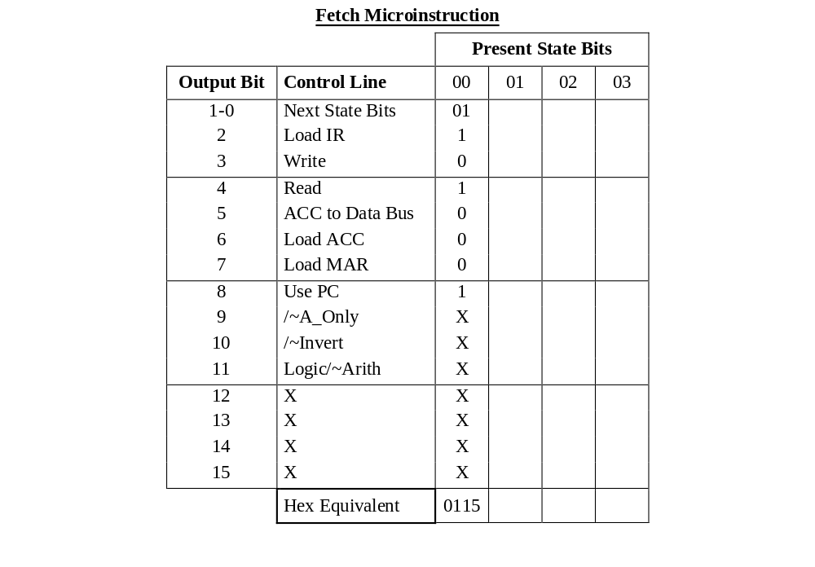
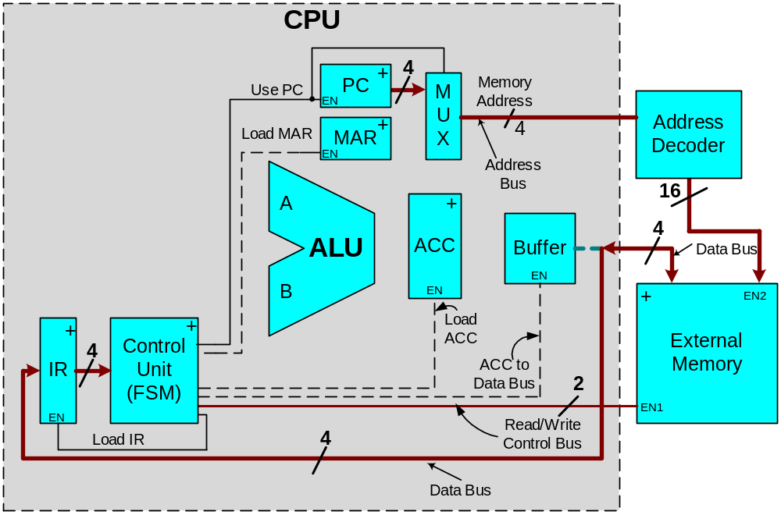
  Let’s define the controller output bits needed to perform the fetch instruction.

Slide 17
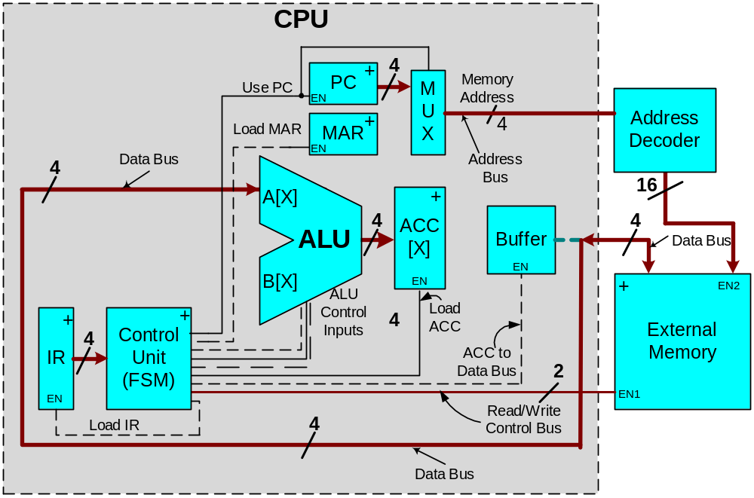
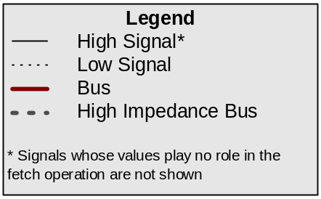
Execute the ‘Load ACC’ opcode.
Enable registers/Control the PC to increment.
Route Data
Enable memory causes memory data to be routed on data bus.
Control ALU to pass-through data.
PC incremented and ACC loaded on clock pulse.
2
1
3
3
LDA
3
Add
5
Stop
LDA

Slide 18
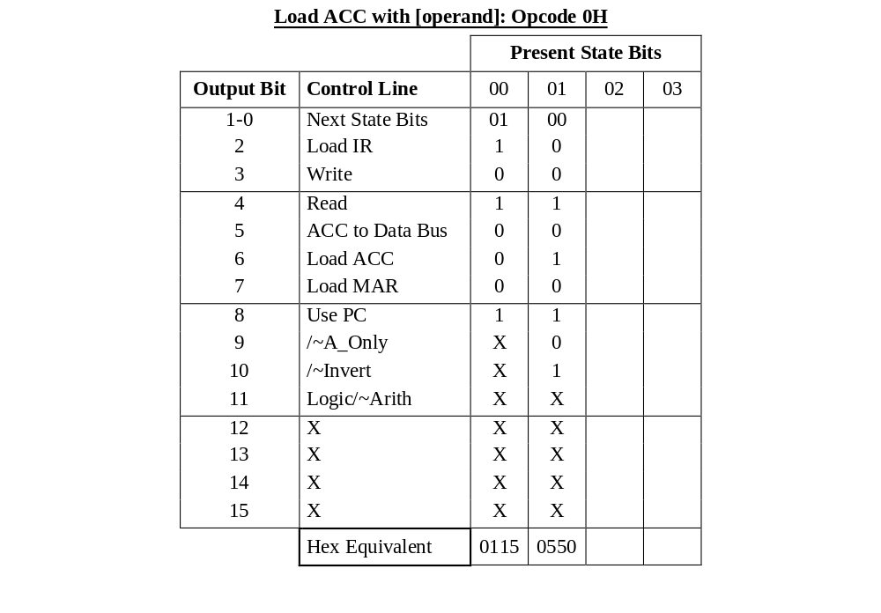
  Let’s define the controller output bits needed to execute the ‘Load ACC’ instruction.
Fetch
Microinstruction
Execute
Microinstruction

Slide 19
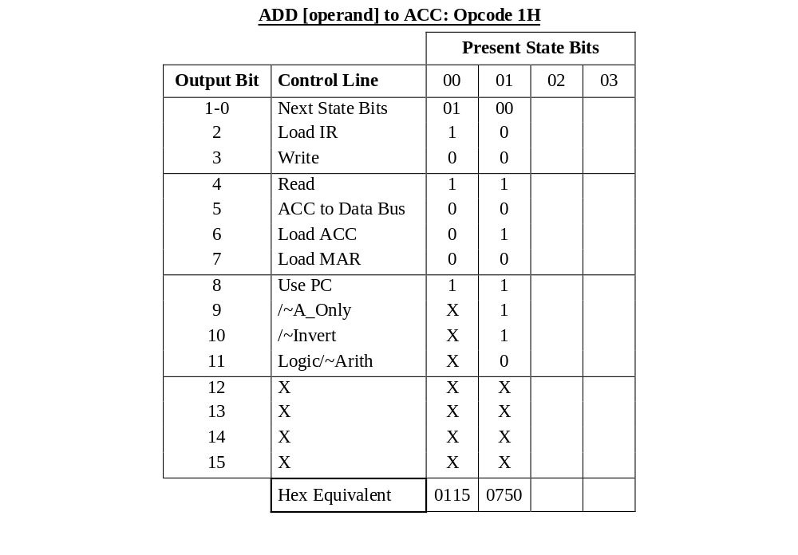


  The ‘Add’ instruction is also made up of a fetch and execute microinstruction.
3
4
5
Fetch
Microinstruction
Execute
Microinstruction
8
LDA
3
Add
5
Stop
ADD
  Let’s look in detail at the execute microinstruction.

Slide 20
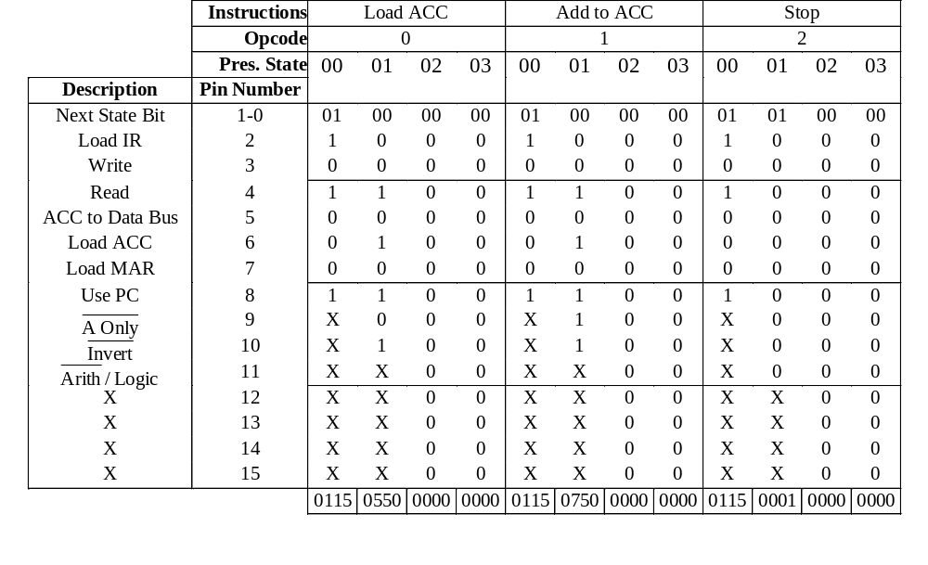
If we add the information needed to implement the stop instruction, we get the following information.
We must enter this information in order into our controller PROM.

Slide 21
In the previous lecture we looked at defining the contents of our controller PROM by observing the controller outputs needed to enable register, route data, and control the ALU.
In this lecture we will look at:
  How the controller accesses the PROM contents when a program is executed.
  How the complete microprocessor executes an example program.

Slide 22
Typically, addresses used to specify memory locations in ROM use Hex codes, with each Hex character representing a 4 bit byte.
A2H = 1010 0010 B
Because each instructions uses 4 micro instruction to complete its tasks, it will be convenient to let our least significant Hex character, represent a 2-bit string.
A2H = 1010 10 B

Slide 23
Microprocessors
•Bit is a binary digit that can have the value 0 or 1
•A byte is defined as 8 bits
•A nibble is half a byte
•A word is two bytes
•A double word is four bytes
•A kilobyte is 2^10 bytes (1024 bytes), The abbreviation K is most often used
–Example: A floppy disk holding 356Kbytes of data
•A megabyte or meg is 2^20 bytes, it is exactly 1,048,576 bytes
•A gigabyte is 2^30 bytes

Slide 24
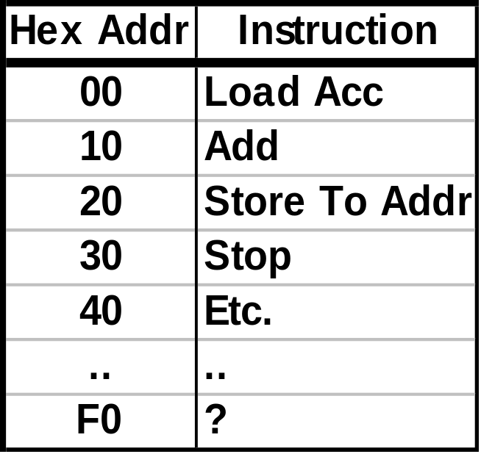
ROM
64 Words X 12 Bits
11
10
9
S5 8
S4 7
S3 6
S2 5
S1 4
S0 3
2
1
0
Each of the instructions in our set requires several tasks to be completed in sequence.
Each sequential task is performed by a microinstruction.
Let’s look at the sequence of Micro Instructions used to Add then Load Acc.

Slide 25
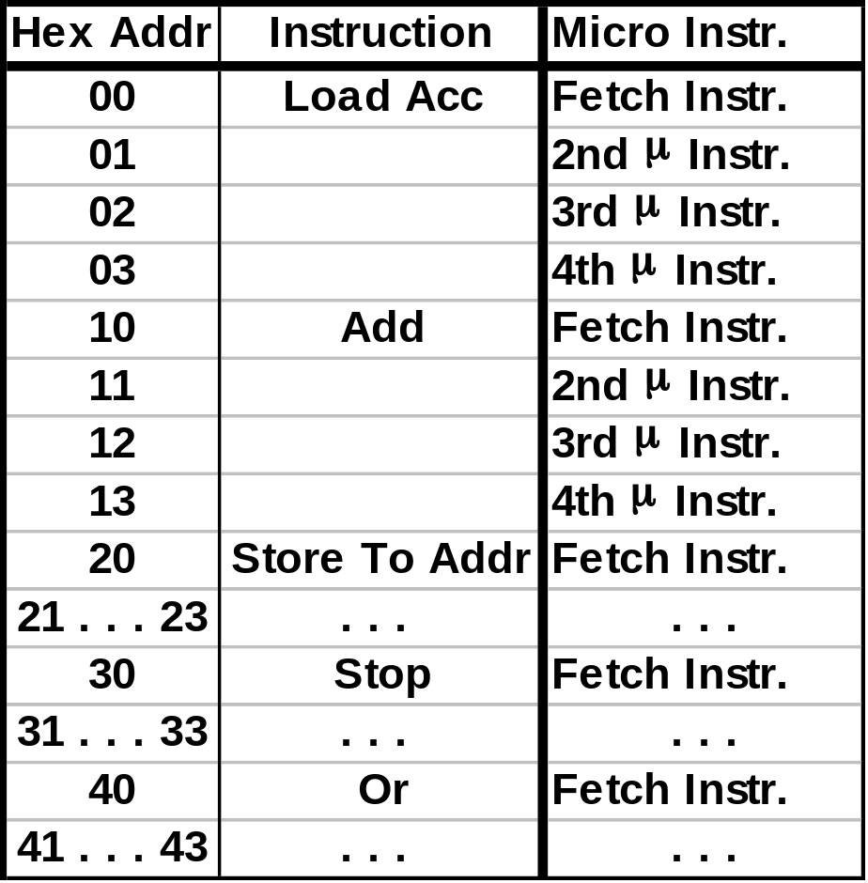
ROM 64 Words X 12 Bits .
11
10
S5 9 S4 8
S3 7
S2 6
S1 5
S0 4
3
2
1
0
Clear
L
d
A
c
0
0
0
0
0
0
0
0
A
d
d
0
0
0
1
1
1
0
0
0
1
1
0
0
0
0
1
1
1
0
0
0
1
1
0
0
1
Another Instr.
Add Instruction = 1H
Load Acc Instruction = 0H
After One Clock Cycle Delay
After One Clock Cycle Delay
After One Clock Cycle Delay
After One Clock Cycle Delay
After One Clock Cycle Delay

Slide 26
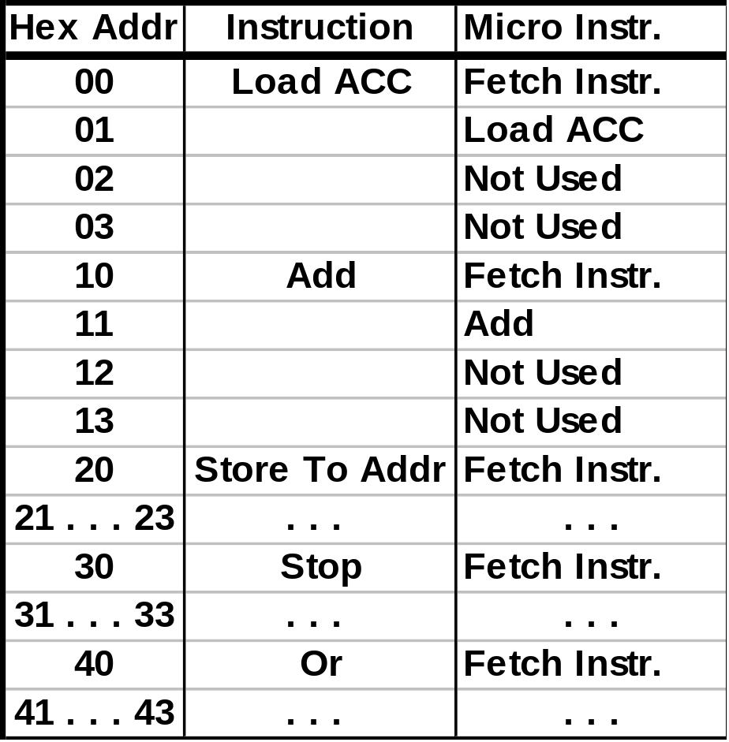
ROM 64 Words X 12 Bits .
11
10
S5 9 S4 8
S3 7
S2 6
S1 5
S0 4
3
2
1
0
Another Instr.
Not all micro instructions allocated for each instruction are needed.

Slide 27
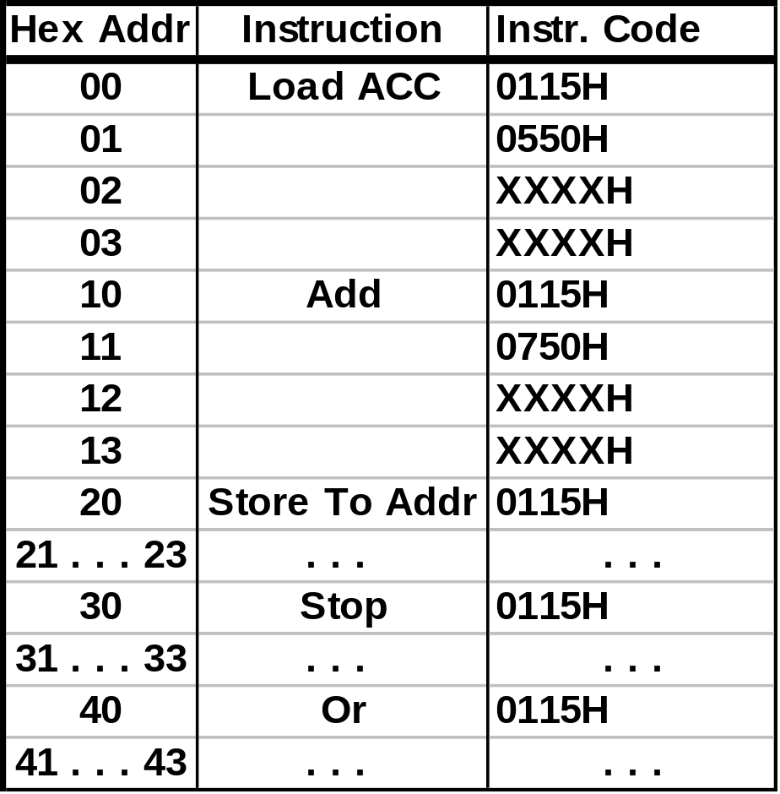
ROM 64 Words X 12 Bits .
11
10
S5 9 S4 8
S3 7
S2 6
S1 5
S0 4
3
2
1
0
Another Instr.
Not all micro instructions allocated for each instruction are needed.

Slide 28
Let’s look specifically at the controller timing for the execution of a small program.
Our program will perform the following:
  Load Acc 3
  Add 5

Slide 29
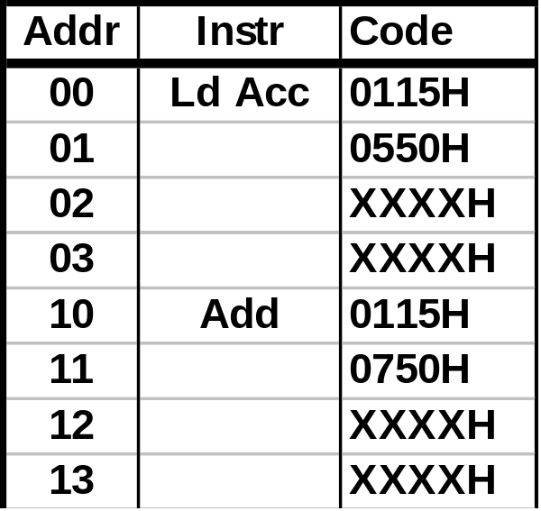
ROM 64 Words X 12 Bits.
11
10
S5 9 S4 8
S3 7
S2 6
S1 5
S0 4
3
Instruction Load 2
MS Sequencing B it 1
LS Sequencing Bit 0
Load Acc
0
0
0
0
IR
A3 Y3
A2 Y2
A1 Y1
A0 Y0
IE .
CLK .
CLR .
0
0
0
0
0115H
Use
PC for
Addr
Read
Seq R
A3 Y3
A2 Y2
A1 Y1
A0 Y0
IE .
CLK .
CLR .
1
0
1
0
1
0
0
Key
0
1
Program:
[Clear]
1
Clock
[Remove Clear]
Clear
Initialization

Slide 30
ROM 64 Words X 12 Bits.
11
10
S5 9 S4 8
S3 7
S2 6
S1 5
S0 4
3
Instruction Load 2
MS Sequencing B it 1
LS Sequencing Bit 0
Data
0
0
1
1
IR
A3 Y3
A2 Y2
A1 Y1
A0 Y0
IE .
CLK .
CLR .
Load Acc
0
0
0
0
0
0
0
0
0550H
Use
PC for
Addr
Read
Seq R
A3 Y3
A2 Y2
A1 Y1
A0 Y0
IE .
CLK .
CLR .
0
0
0
0
0
0
1
0
1
0
0
Key
0
1
Program:
[Clear]
1
Clock
[Remove Clear]
Clear
Load Acc (Clk Pulse)
Load Accumulator: Micro Instruction 1

Slide 31
ROM 64 Words X 12 Bits.
11
10
S5 9 S4 8
S3 7
S2 6
S1 5
S0 4
3
Instruction Load 2
MS Sequencing B it 1
LS Sequencing Bit 0
Add
0
0
0
1
IR
A3 Y3
A2 Y2
A1 Y1
A0 Y0
IE .
CLK .
CLR .
Data
0
0
1
1
0
0
0
0
0115H
Use
PC for
Addr
Read
1
0
1
Seq R
A3 Y3
A2 Y2
A1 Y1
A0 Y0
IE .
CLK .
CLR .
0
0
0
0
0
0
1
0
0
0
1
Key
0
1
Program:
[Remove Clear]
1
Clock
Load Acc (Clk Pulse)
Clear
Load Acc (Pulse 2)
Load Accumulator: Micro Instruction 2

Slide 32
ROM 64 Words X 12 Bits.
11
10
S5 9 S4 8
S3 7
S2 6
S1 5
S0 4
3
Instruction Load 2
MS Sequencing B it 1
LS Sequencing Bit 0
Data
0
1
0
1
IR
A3 Y3
A2 Y2
A1 Y1
A0 Y0
IE .
CLK .
CLR .
Add
0
0
0
1
0
0
0
1
0
0
0
0
Use
PC for
Addr
0750H
Read
0
0
0
Seq R
A3 Y3
A2 Y2
A1 Y1
A0 Y0
IE .
CLK .
CLR .
1
0
1
0
1
0
1
0
0
0
0
Key
0
1
Program:
Load Acc (Clk Pulse)
1
Clock
Load Acc (Pulse 2)
Clear
Add (Pulse 1)
Add: Micro Instruction 1

Slide 33
ROM 64 Words X 12 Bits.
11
10
S5 9 S4 8
S3 7
S2 6
S1 5
S0 4
3
Instruction Load 2
MS Sequencing B it 1
LS Sequencing Bit 0
Next Instr
?
?
?
?
IR
A3 Y3
A2 Y2
A1 Y1
A0 Y0
IE .
CLK .
CLR .
Data
0
1
0
1
0
0
0
1
Use
PC for
Addr
0115H
Read
1
0
1
Seq R
A3 Y3
A2 Y2
A1 Y1
A0 Y0
IE .
CLK .
CLR .
0
0
0
0
0
0
1
0
1
0
0
Key
0
1
Program:
Load Acc (Pulse 2)
1
Clock
Add (Pulse 1)
Clear
Add (Pulse 2)
Add: Micro Instruction 2

Slide 34
Definition of PC
Now let’s integrate the controller into the brainless microprocessor.
First we’ll enter the program:
  Load Acc 3
  Add 5
Then we’ll execute the program using the controller we’ve just examined.

Slide 35
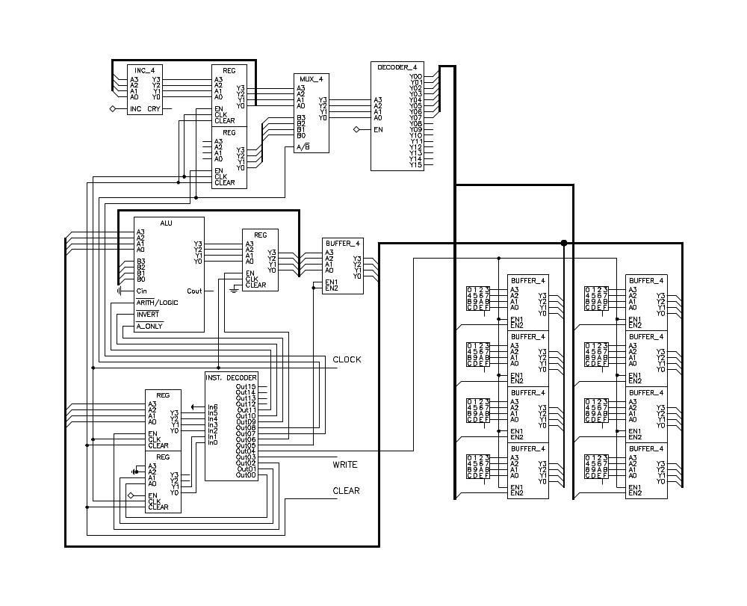
See Notes for Annotation
1
1
2
0
1
0
0
0
0
Negate
(-1)
0
0
0
0
0
3
0
0
0
1
1
0
5
0
1
5
READ
5
5
0
0
0
0
1
Notes:
SLIDE 1
Program the μP.
Instruction Code Location
MOVE ACC 0 0
DATA 3 1
ADD 1 2
DATA 5 3
Set CLEAR to 1
This sets PC to 0 and the increments input of PC to 1 (PC = Program Counter)
AR is set to 0 (AR = Address Register)
IR is cleared to 0 (IR = Instruction Register)
SR is cleared to 0 (SR = Sequencing Register)
Set CLEAR to 0.
This sets the output of the Instruction Decoder to 0115
SR input is set to 01
IR is enabled
Write = 0
Read = 1
ACC output buffer is disabled (Read from ACC)
ACC is disabled (Write to ACC)
AR is disabled
PC is enabled and selected on MUX
This addresses Mem0. Instruction 0 from Mem0 appears at IR and ALU.
ALU is set to 0, 0, 0
This sets ALU to NEGATE. Hence output of ALU = 0.
Next CLOCK the μP.
The 0 at the IR input moves to the Instruction Decoder Input
The 01 at the SR input moves to the Instruction Decoder Input
This sets instruction Decoder output to 0550
PC is set to 1 and input to PC is incremented to 2.

Slide 36
See Notes for Annotation
2
1
3
1
2
0
1
0
0
0
3
0
Pass
Through
3
3
3
0
0
1
0
3
0
0
0
1
3
5
0
1
5
1
READ
0
5
5
0
1
0
0
Notes:
SLIDE 2
Note conditions at end of last slide
Instruction Decoder output is 0550
SR input is set to 00
IR is disabled
Write = 0
Read = 1
ACC output buffer is disabled (Read from ACC)
ACC is enabled (Write to ACC)
AR is disabled
PC is enabled and selected on MUX
This addresses Mem1. Data 3 from Mem1 appears at IR and ALU.
ALU is set to 0, 1, 0
This sets ALU to PASS THROUGH. Hence output of ALU = 3.
Next CLOCK the μP.
Data 3 is stored in ACC.
3 appears at input B of ALU
PC is set to 1 and input to PC is incremented to 2.
The 00 at the SR input moves to the Instruction Decoder Input
This sets instruction Decoder output to 0115

Slide 37
See Notes for Annotation
3
1
4
2
3
1
2
0
0
3
1
3
Negate
(-1)
F
3
3
0
0
0
0
3
0
0
3
1
1
1
0
7
1
1
5
READ
5
5
0
0
0
0
1
Notes:
SLIDE 3
Note conditions at end of last slide
Instruction Decoder output is 0115
SR input is set to 01
IR is enabled
Write = 0
Read = 1
ACC output buffer is disabled (Read from ACC)
ACC is disabled (Write to ACC)
AR is disabled
PC is enabled and selected on MUX
This addresses Mem2. Instruction 1 from Mem2 appears at IR and ALU.
ALU is set to 0, 0, 0
This sets ALU to NEGATE. Hence output of ALU = F
Next CLOCK the μP.
PC is set to 3 and input to PC is incremented to 4.
The 1 at the IR input moves to the Instruction Decoder Input
The 01 at the SR input moves to the Instruction Decoder Input
This sets instruction Decoder output to 0750

Slide 38
See Notes for Annotation
4
1
5
3
4
2
3
0
0
1
5
F
8
ADD
(+)
D
3
8
3
8
0
0
1
1
3
0
0
1
1
5
7
1
1
5
1
READ
0
5
5
0
1
0
0
Notes:
SLIDE 4
Note conditions at end of last slide
Instruction Decoder output is 0750
SR input is set to 00
IR is disabled
Write = 0
Read = 1
ACC output buffer is disabled (Read from ACC)
ACC is enabled (Write to ACC)
AR is disabled
PC is enabled and selected on MUX
This addresses Mem3. Data 5 from Mem3 appears at IR and ALU.
ALU is set to 0, 1, 1
This sets ALU to ADD. Hence output of ALU = 8.
Next CLOCK the μP.
Data 8 is stored in ACC.
8 appears at input B of ALU
Since ALU is in the ADD Mode Output of ALU is D
PC is set to 4 and input to PC is incremented to 5.
The 00 at the SR input moves to the Instruction Decoder Input
This sets instruction Decoder output to 0115

